Slide 1

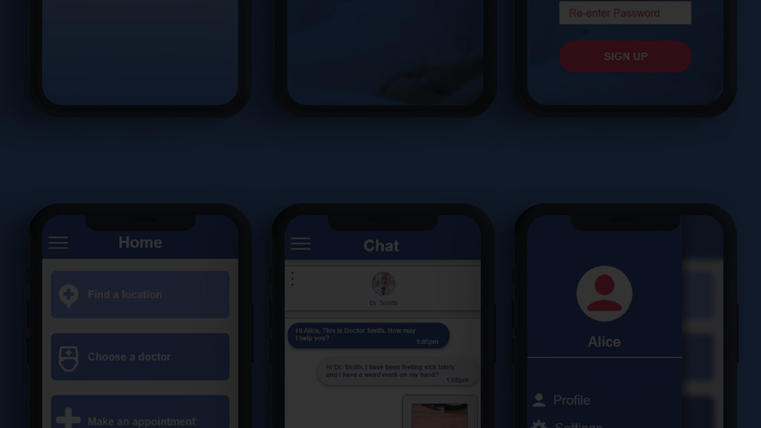
Revolutionizing Remote Patient Monitoring with a Mobile Health Website
In today's fast-paced, interconnected world, the healthcare industry is undergoing a transformative shift towards remote patient monitoring. By leveraging the power of mobile technology, healthcare providers can now deliver personalized, accessible, and efficient care to patients, regardless of their physical location. This document will guide you through the key features, design considerations, and technological integrations necessary to create a mobile health website that revolutionizes remote patient monitoring.

Slide 2

Key Features of a Mobile Health Website for Remote Patient Monitoring
A cutting-edge mobile health website for remote patient monitoring should incorporate a suite of innovative features that empower both patients and healthcare providers. From real-time data tracking and visualization to secure telemedicine integrations, these capabilities are essential for delivering comprehensive, personalized care.
1
Intuitive User Interface
2
Remote Monitoring Capabilities
The website should feature a clean, user-friendly design that makes it easy for patients to navigate and access their health information. Intuitive navigation, clear data presentation, and seamless communication channels are key to ensuring a positive user experience.
Integrating with a variety of medical devices and sensors, the website should enable patients to track and share their vital signs, symptoms, and other health data in real-time. This empowers patients to play a more active role in their care while providing healthcare providers with valuable insights.
3
Personalized Care Plans
The website should allow healthcare providers to customize care plans and treatment recommendations based on each patient's unique health profile and needs. This personalized approach helps to ensure that patients receive the most effective and tailored care possible.

Slide 3
Designing for a User-Friendly Experience
Crafting a user-friendly mobile health website is crucial for driving patient engagement and fostering trust in the remote patient monitoring system. By prioritizing intuitive navigation, clear information architecture, and accessible features, healthcare providers can create a seamless experience that encourages patients to actively participate in their care.
Intuitive Navigation
Visual Clarity
Accessibility Features
The website's navigation should be straightforward and easy to understand, with clear labeling and hierarchical organization of content. Patients should be able to quickly find the information and features they need, whether it's accessing their health data, communicating with their healthcare team, or scheduling appointments.
The website's design should prioritize clear and concise data visualization, with intuitive graphs, charts, and dashboards that help patients understand their health status at a glance. The use of color, typography, and layout should enhance readability and comprehension.
To ensure an inclusive user experience, the website should incorporate accessibility features such as adjustable text sizes, high-contrast modes, and support for screen readers. This ensures that patients of all abilities can seamlessly navigate and interact with the platform.

Slide 4
Integrating with Medical Devices and Sensors
Seamless integration with a variety of medical devices and sensors is a crucial component of a comprehensive remote patient monitoring system. By enabling the secure and seamless transfer of patient data, the mobile health website can provide healthcare providers with real-time insights to inform personalized care plans and treatment decisions.
Bluetooth Connectivity
1
The website should offer Bluetooth connectivity, allowing patients to easily pair their personal health devices, such as blood pressure monitors, glucose meters, and fitness trackers, with the platform. This ensures that data is automatically and securely transmitted to the healthcare provider's dashboard.
2
API Integration
The website should feature robust API integration capabilities, enabling it to connect with a wide range of medical devices and sensors. This flexibility ensures that patients can utilize the devices and technologies they are most comfortable with, creating a personalized and empowering remote monitoring experience.
Data Visualization
3
The website should offer advanced data visualization tools, transforming the raw data from connected devices into meaningful, actionable insights. Interactive graphs, charts, and dashboards help healthcare providers quickly identify trends, spot anomalies, and make informed decisions about patient care.

Slide 5


Ensuring Data Security and Privacy
In the realm of remote patient monitoring, safeguarding patient data is of paramount importance. The mobile health website must incorporate robust security measures and compliance protocols to protect the sensitive health information entrusted to the platform.
Encryption and Authentication
The website should employ the latest encryption technologies to secure data transmission and storage, ensuring that patient information remains confidential and protected from unauthorized access. Additionally, robust authentication protocols, such as two-factor authentication, should be implemented to verify user identities.
HIPAA Compliance
The website must be designed and operated in strict adherence to HIPAA (Health Insurance Portability and Accountability Act) regulations, which govern the handling and protection of protected health information (PHI). Compliance with these standards is essential for maintaining patient trust and safeguarding sensitive data.
Audit Trails and Monitoring
The website should incorporate comprehensive audit trails and real-time monitoring capabilities to track all user activities and data access. This allows healthcare providers to quickly identify and address any potential security breaches or unauthorized access attempts.
Transparent Data Policies
The website should feature clear and transparent data policies that outline how patient information is collected, stored, and used. This level of transparency helps to build trust and ensure that patients feel empowered and in control of their personal health data.

Slide 6





Optimizing for Mobile Responsiveness
As a mobile health website, it is crucial that the platform be designed with a mobile-first approach, ensuring a seamless and responsive user experience across a variety of devices and screen sizes. By prioritizing mobile optimization, healthcare providers can ensure that patients can access and interact with the platform anytime, anywhere.
Responsive Design
Offline Capabilities
The website should feature a responsive design that automatically adjusts its layout and content to the user's device, whether they are accessing it on a smartphone, tablet, or desktop computer. This ensures optimal readability, navigation, and functionality regardless of the patient's device.
The website should incorporate offline capabilities, allowing patients to access and interact with key features, such as viewing their health data and communicating with their healthcare team, even in areas with limited or intermittent internet connectivity.
Push Notifications
Streamlined User Experience
The website should leverage push notifications to keep patients informed about important updates, appointment reminders, and health alerts. This proactive communication helps to ensure that patients remain engaged and informed, leading to better health outcomes.
The website's user experience should be optimized for mobile devices, with intuitive navigation, concise content, and a focus on essential features. This streamlined approach ensures that patients can quickly and easily access the information and functionality they need on-the-go.

Slide 7



Integrating Telemedicine and Virtual Care
To fully leverage the power of remote patient monitoring, the mobile health website should seamlessly integrate telemedicine and virtual care capabilities. By enabling secure, real-time communication between patients and healthcare providers, the platform can facilitate more personalized, accessible, and efficient care delivery.
Video Consultations
Secure Messaging
Remote Treatment Monitoring
The website should offer video conferencing functionality, allowing patients to participate in virtual consultations with their healthcare providers. This enables face-to-face interactions and facilitates the discussion of sensitive health topics, while reducing the need for in-person visits.
The website should provide a secure messaging platform, enabling patients to communicate directly with their healthcare team regarding questions, concerns, or updates to their health status. This asynchronous communication channel enhances the patient-provider relationship and supports timely interventions.
The website should allow healthcare providers to remotely monitor and adjust patient treatment plans, leveraging the real-time data collected through the connected devices and sensors. This enables proactive care management and ensures that patients receive the most effective and personalized care possible.

Slide 8
Conclusion: Embracing the Future of Remote Patient Monitoring
The development of a cutting-edge mobile health website for remote patient monitoring represents a transformative step in the evolution of healthcare delivery. By seamlessly integrating cutting-edge technology, personalized care, and robust security measures, this platform empowers patients to take a more active role in their health while enabling healthcare providers to deliver comprehensive, efficient, and accessible care. As the healthcare industry continues to embrace the power of digital technologies, the mobile health website showcased in this document stands as a shining example of how remote patient monitoring can revolutionize the patient experience and improve overall health outcomes.
Take the first step towards revolutionizing remote patient care by partnering with our team of expert web designers and healthcare technology specialists. Together, we can create a mobile health website that redefines the future of patient-centric care.

